Slide 1
Transforming Business through Technology

Slide 2
http://www.shutterstock.com/pic-294618722/stock-photo-businessman-looking-at-a-graph-on-his-computer.html?src=aOnjMeERFawM8TdChg8vZA-1-4
THE PROBLEM?
He’s out of resources from the previous loan, and getting another bank loan approved will prove difficult, if not impossible.
Meet Rahul. Rahul is a well-educated businessman trying to make an honest living in the world of IT Distribution. Recently, he took out a bank loan to finance his working capital, which involved providing collateral and a seemingly endless pile of paperwork. Then he received another offer – a golden opportunity to become the IT supplier for a multi-branch hospital chain.
SOUND FAMILIAR?

Slide 3
Our niche area?
IT DISTRIBUTION.
Our very specific clientele ensures that we know the business inside and out – challenges, dilemmas and all. We offer channel partners in various supply chains quick and easy access to financing programs and options including working capital loans, extended net terms and accounts receivable schemes
Well, with X10 Financial Services, you can choose to seize growth opportunities instead of letting them pass you by.
3

Slide 4
Let’s do a quick comparison between bank loans and X10 Financial Services.
Bank loans require collateral, while X10 Financial Services provide unsecured loans. Bank loans also involve tedious, time-consuming paperwork, while X10 utilizes technology to provide hassle-free and time-saving applications. Moreover, utilization limits are regulated by banks, while we give you the freedom to utilize your limits however you want. With additional bank loans, you’ll need an NOC, but we don’t require it.
BANK LOANS
Require collateral
Tedious, time-consuming paperwork
Utilization limits are regulated
Requires NOC
X10 FINANCIAL SERVICES
Collateral-free
Hassle-free and quick processing
Freedom to utilize your limit
No NOC required

Slide 5
What makes X10 Financial Services stand out among other NBFCs? We provide
Additional credit to the borrower
Complete focus on core distribution business
Enhanced cash flows
100% payment guarantee
Instant liquidity
Special performance-based incentives
What’s more, X10 Financial Services is a pioneer in using technology to deliver financial solutions, helping you make informed decisions from the comfort of your own office.

Slide 6
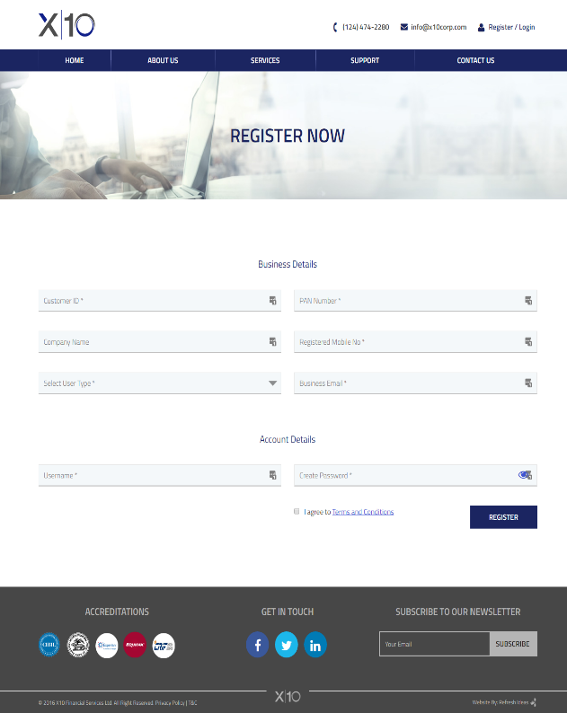
Sounds too good to be true? There’s only one way to find out.
An OTP will be generated and shared via your registered email ID and mobile number. Enter the OTP received to verify your account.
Click “Register Now” and fill in the details required.
Login to gain access to information regarding your limit with us.
Login to our website
www.x10corp.com
Start by
CREATING YOUR ACCOUNT
01
02
03
04
CREATING YOUR ACCOUNT

Slide 7
Do you desire more efficiency and transparency of your credit limit? Our online dashboard is a revolutionary system that provides you with just that. Our state-of-the-art Complete Limit Management tool allows you to obtain information on the following:
Our limit tracking tool will enable you to not only forecast the business and fresh orders, but also develop an informed billing mechanism. We do this through providing the following features:
Loan Application Procedure
Monitoring Limit Utilization
Customer Service Requests
Payment details
Disbursement by uploading invoices
Limit Enhancement
Replenishment Analysis
Available limits of your partners
Unpaid invoices
Forecasting for generating new invoices
Cash Flow Management

Slide 8
Let’s take a closer look at the overview page:
Scroll down a little, and you’ll come to Limit Details. Here, you can check your credit limit, how much you’ve utilized and how much is available for further utilization.
At the end of the page, you’ll come to Replenishment Analysis. If loan instalments are paid back for the next 30 days, you’ll get to replenish your limits.
At the top, we have the details of the borrower and business relations.
Next, you’ll see a graph displaying your Disbursement Trend.
Keeping track of your credit has never been easier

Slide 9
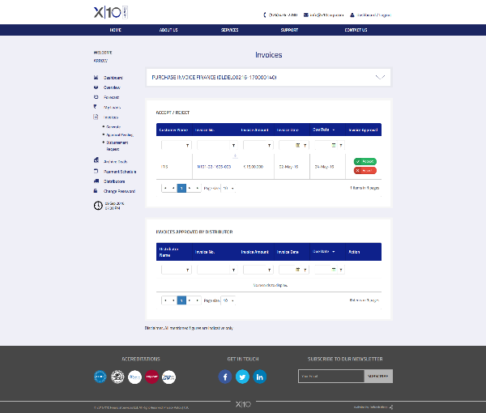
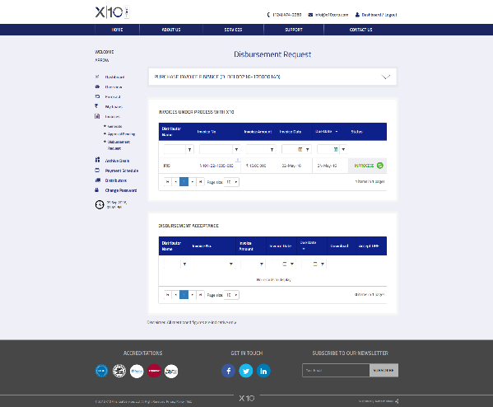
Now, on to the real question: How exactly does the loan process work?
Go to “Invoices” where you’ll see three subsections –
Generate, Approval Pending, and Disbursement Request.
At the Generate stage, your limit details will be displayed clearly at the top of the page. Upload and submit your invoice along with other required information. This invoice immediately goes to the distributor concerned for confirmation. Once confirmed, it will show up on the panel.
After the invoice has been vetted by the distributor, you can submit the Loan Request to X10. When approved, X10 will send back loan terms.
The last stage is the Disbursement Request where you accept the terms and conditions of the loan.

Slide 10
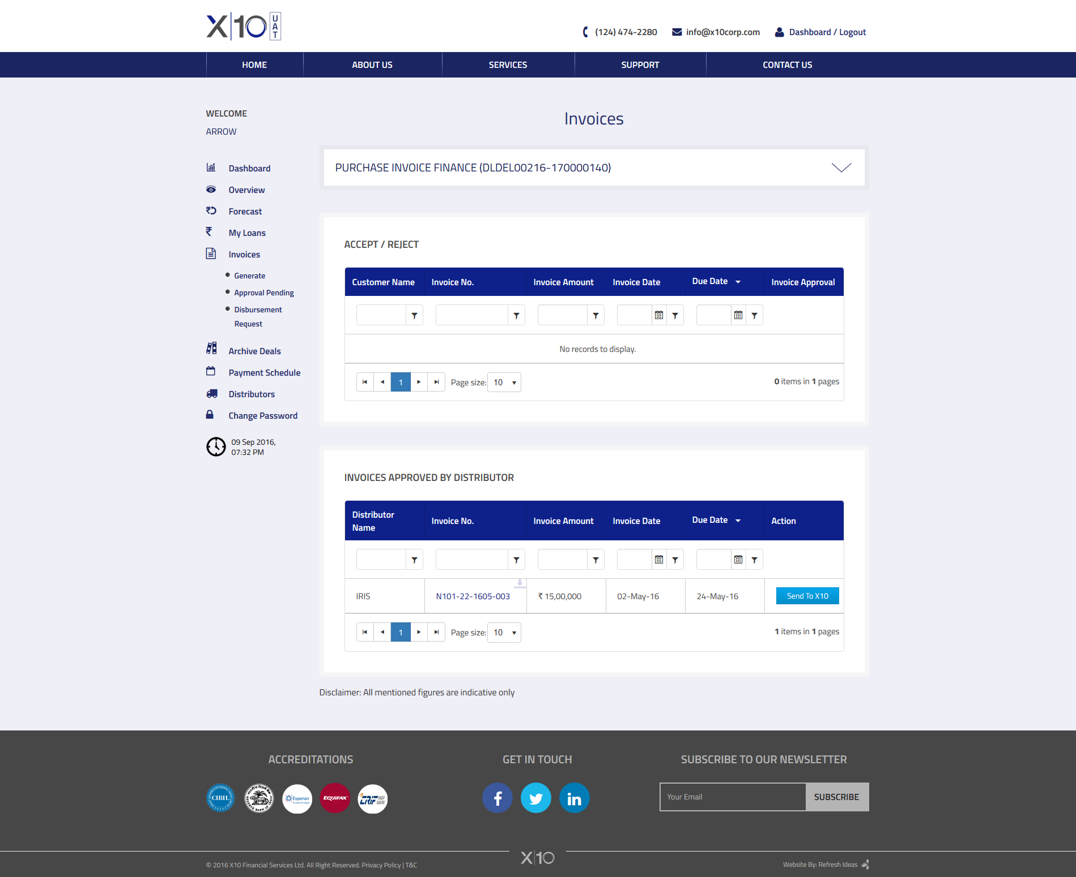
So let’s recap.
In 4 simple steps, you can gain hassle-free, immediate access to working capital finance to grow your business.
01
Check whether your distributor is empanelled with X10 Financial Services Ltd.
02
Submit your loan application
03
Get your credit limit assigned
04
Upload invoices for loan disbursements.
WE’LL TAKE CARE OF IT FROM THERE.

Slide 11
At X10 Financial Services, we’ve got your back. Let us help you to manage your investment needs so you can work towards your goals with confidence.
DO 10 X BUSINESS WITH X10 DISTRIBUTION NETWORK.

